Slide 1
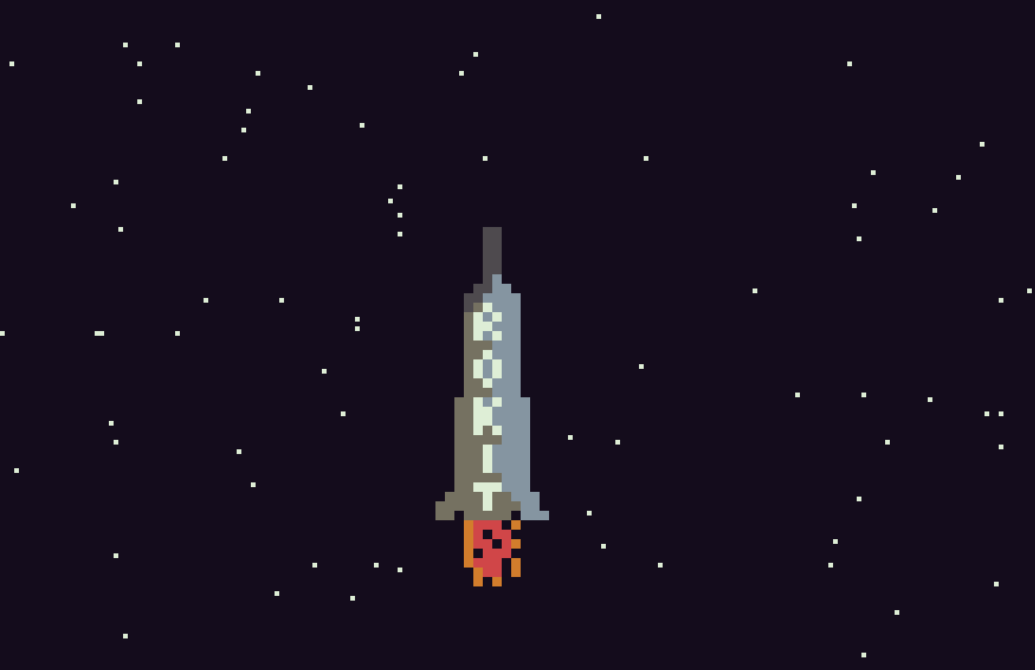

Slide 2
To Do
Help screen with controls and instructions
Show score (60 ticks =10 metres – only counts if finger on button)
Explosion for end game
Sky colour – STARTED
Added facility for coloured stars (on/off)
Music started
-------
Mission
Remove wings on takeoff
Deploy payload
Allow retros to fire and release landing legs
Add power-ups
Add things to bump into and kill you or hurt you
Possibly add left and right steering…..
Save game ?
Add random comets flying across the screen as you get higher (started)
Planets
Different rockets
http://educationmusicale.ac-besancon.fr/wp-content/uploads/sites/42/2015/10/Piano_Copland.pdf

Slide 3
Done
Story screen after 2 mins delay on main screen (Like star wars)
Added facility for coloured stars (on/off)
Show launchpad
Allow rocket to drop back when no button is pressed (along with a corresponding delay to the starfield)
Show fuel
Show heat
When rocket dropping back, fuel stops, but when it hits the bottom of the screen, it should explode…..
Finish start screen with skyrokit logo and copyright image
Redid launch pad
Make starfield start blank, then steadily increase the amount of stars
Make rocket able to go higher on the screen

Slide 4
Bugs
Launchpad needs to disappear correctly when rocket takes off
When power is not applied. heat should drop back

Slide 5
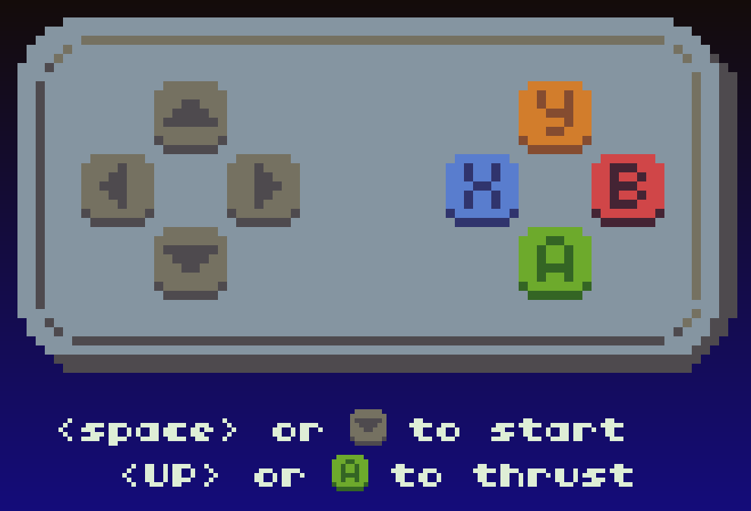
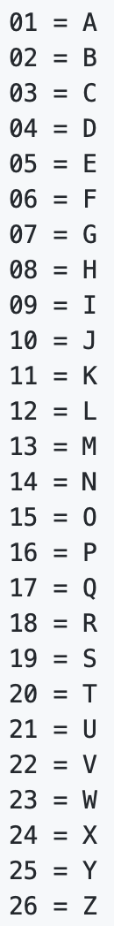
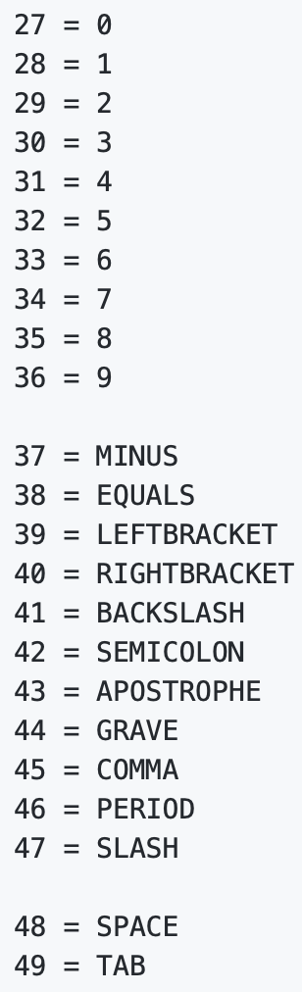
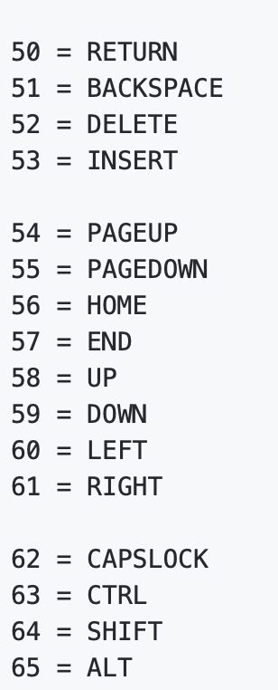
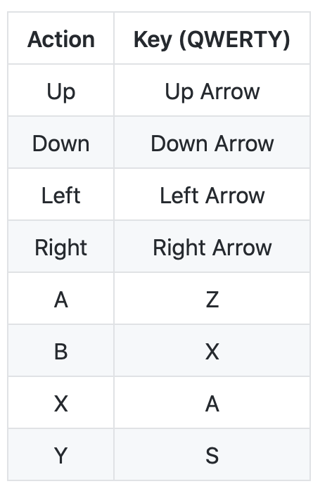
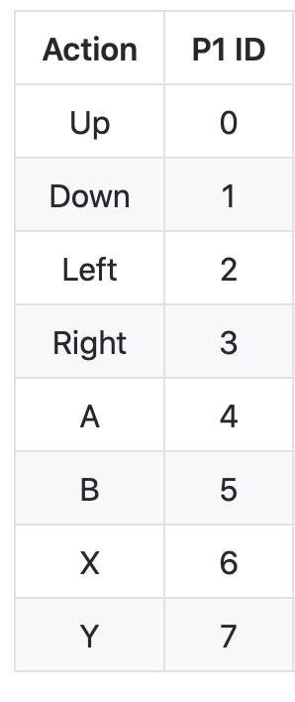
DEFAULT KEYMAP
P1 KEYMAP
FUNCTION | KEYBOARD | NUMBER KEYP() | PAD | NUMBER BTNP() | DEFAULT KEYBOARD
START GAME | SPACE | 48 | X | 6 | ---
THRUST | UP | 58 | A | 4 | Z
LANDING GEAR | DOWN | 59 | DOWN | 1 | DOWN
RELEASE PAYLOAD | Q | 17 | UP | 0 | UP
LEFT | LEFT | 60 | LEFT | 2 | LEFT
RIGHT | RIGHT | 61 | RIGHT | 3 | RIGHT
TOGGLE SOUND | S | 19 | Y | 6 | S
TOGGLE MUSIC | A | 1 | B | 7 | X
HELP ^{*front screen only} | H | 8 | UP | 0 | UP

Slide 6

Story
Not so long ago in a place
which is familiar to most....
It is a period of intense competition.
Many tests of different ships have
been done in hidden proving grounds,
The first steps against government controlled space flight have begun.
During the tests, one mighty space
vehicle towers way above the rest.
It is the ultimate construction; the SKY ROKIT, a lean, sleek, beautiful piece of engineering ship with enough power to beat the others to the sky.
Pursued by the others, there is a rush to get the starship into the depths
of space in order to show that the minnows can outsmart the sharks and gain freedom for the skies .....
Landing Gear
This Photo by Unknown Author is licensed under CC BY-SA

Slide 7

https://www.1001fonts.com/homoarakhn-font.html#styles

Slide 9
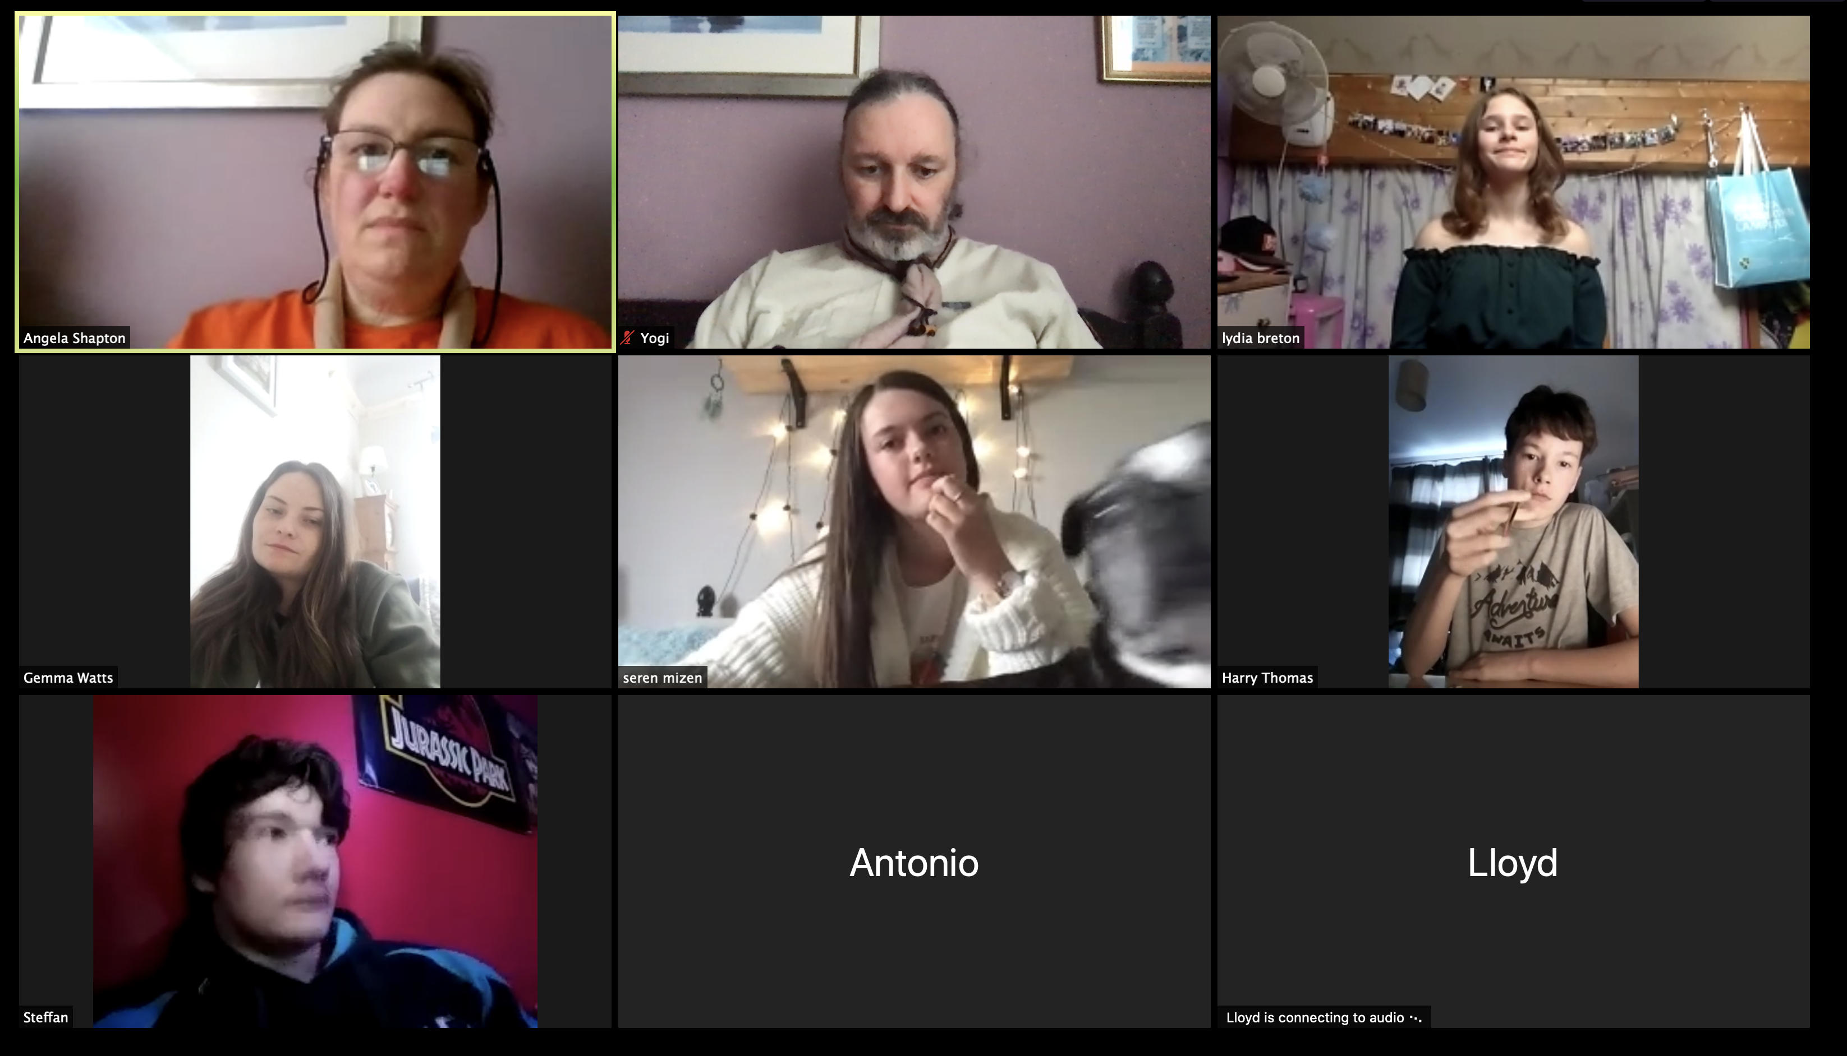

Slide 10
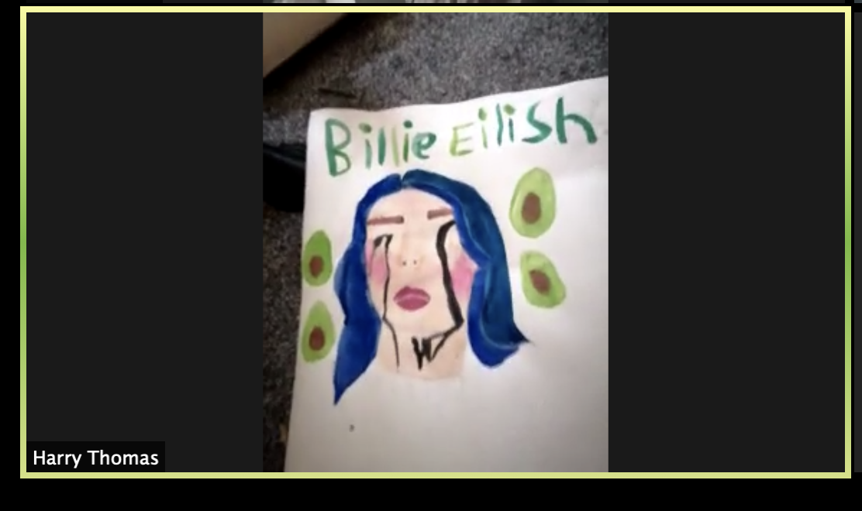

Slide 11
